Slide 1
The Nature Conservancy Fisheries Monitoring
Yinhao Xiao
Juru Huang
Szu-Ling Chen

Slide 2
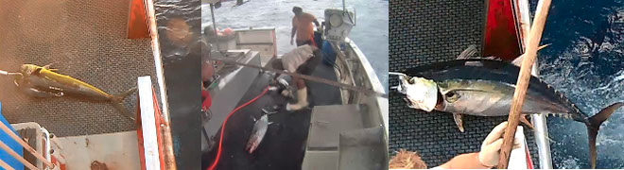
Background (Meaning of the competition)
Nearly half of the world depends on seafood for their main source of protein. In the Western and Central Pacific, where 60% of the world’s tuna is caught, illegal, unreported, and unregulated fishing practices are threatening marine ecosystems, global seafood supplies and local livelihoods. The Nature Conservancy is working with local, regional and global partners to preserve this fishery for the future.

Slide 3
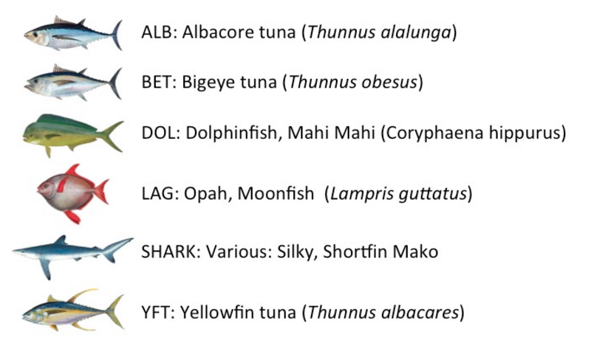
Cont..
There are 6 kinds of fishes we need to classify.

Slide 4
Problem Definition
We have 8 classifications in total, besides the previous 6 types of fishes, there are 2 more which are “No Fish” and “Other Fish”.
No Fish: There is no fish in the whole image
Other Fish: There is fish in the image but the fish does not belong to the previous 6 types of fish.

Slide 5
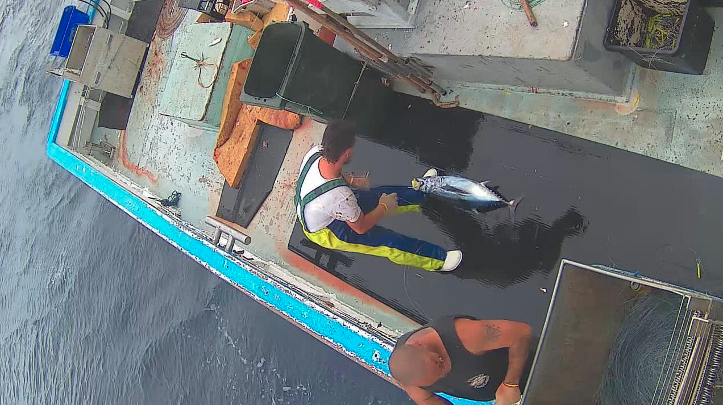
Cont.. some sample images

Slide 6
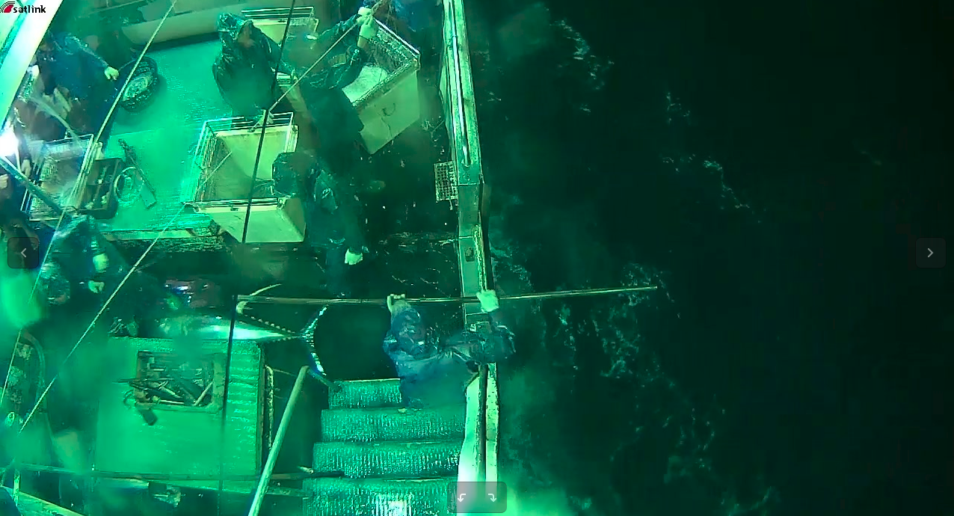

Slide 7
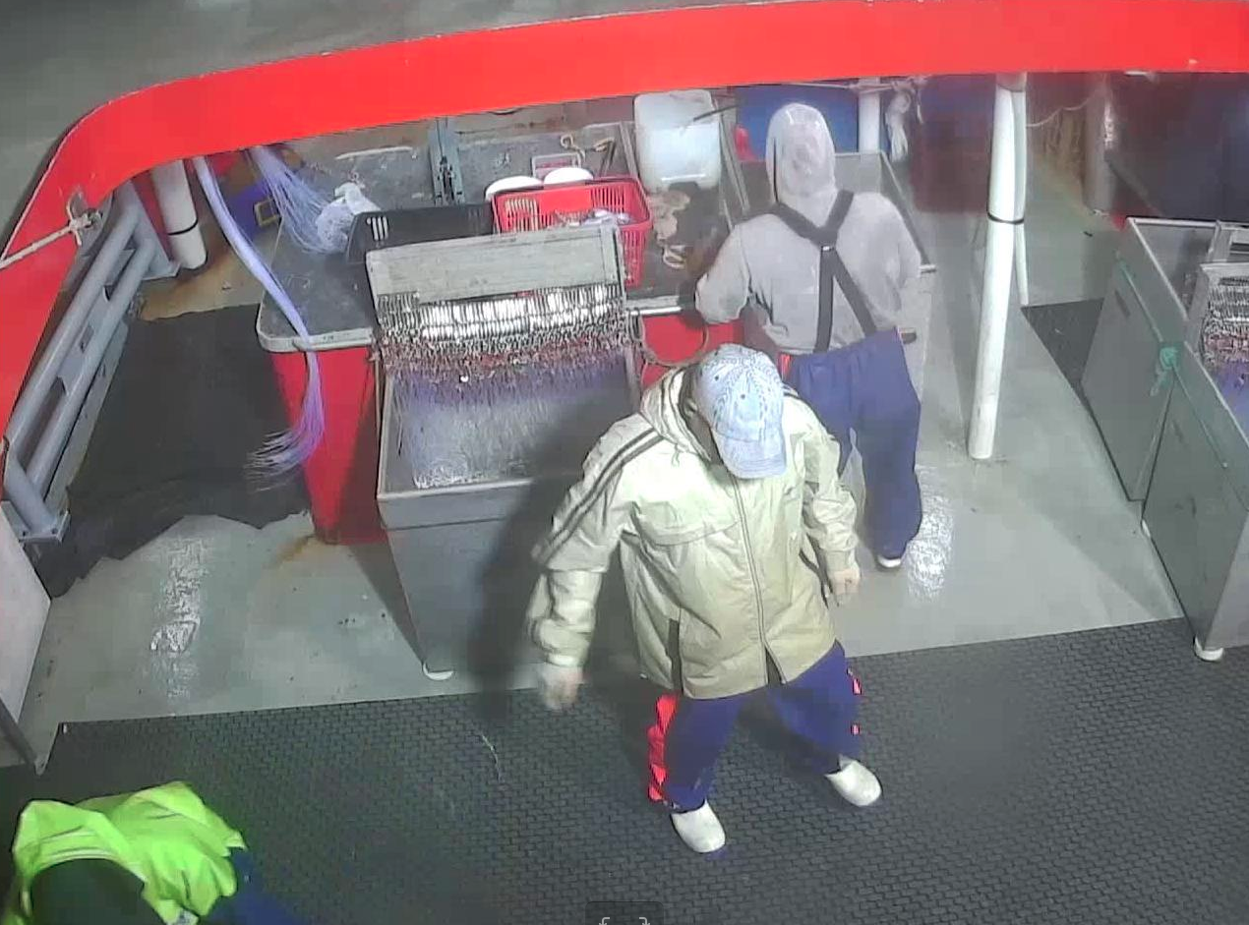

Slide 8
Approaches
We have tried multiple models:
2-step (Fish detection+recognition) method with R-CNN (Region based CNN)
For detection: Sliding window + Revised O-NET; For recognition: Revised Zeiler&Fergus Net
For detection: Region of Interest(ROI) such as Selective search + Revised O-NET; For recognition: VGG-16/Revised Zeiler&Fergus Net
For detection: Bounding box regression with O-NET and Zeiler&Fergus Net; For recognition: VGG-16 and Zeiler&Fergus Net
Whole image prediction
Zeiler&Fergus Net
VGG-16

Slide 9
Revised O-Net for Fish Detection
Layer | Input Size | Output size | Kernel
Conv1 | 48x48x3 | 48x48x32 | 3x3x3
Pool1 | 48x48x32 | 16x16x32 | 3x3x32
Conv2 | 16x16x32 | 16x16x64 | 3x3x32
Pool2 | 16x16x64 | 6x6x64 | 3x3x64
Conv3 | 6x6x64 | 6x6x64 | 3x3x64
Pool3 | 6x6x64 | 3x3x64 | 2x2x64
Conv4 | 3x3x64 | 3x3x128 | 2x2x64
FC1 | 1152 | 256
Dropout
FC2 | 256 | 2

Slide 10
Revised Zeiler&Fergus Net for Recognition
Layer | Input Size | Output Size | Kernel
Conv1 | 220x220x3 | 110x110x64 | 7x7x3
Pool1 | 110x110x64 | 55x55x64 | 3x3x64
Batch norm
Conv2a | 55x55x64 | 55x55x64 | 1x1x64
Conv2 | 55x55x64 | 55x55x128 | 3x3x64
Batch norm
Pool2 | 55x55x128 | 28x28x128 | 3x3x128
Conv3a | 28x28x128 | 28x28x128 | 1x1x128
Conv3 | 28x28x128 | 28x28x256 | 3x3x128
Pool3 | 28x28x256 | 14x14x256 | 3x3x256

Slide 11
Cont..
Layer | Input Size | Output Size | Kernel
Batch norm
Conv4a | 14x14x256 | 14x14x256 | 1x1x256
Conv4 | 14x14x256 | 14x14x256 | 3x3x256
Batch norm
Conv5a | 14x14x256 | 14x14x256 | 1x1x256
Conv5 | 14x14x256 | 14x14x256 | 3x3x256
Batch norm

Slide 12
Cont..
Layer | Input Size | Output Size | Kernel
Conv6a | 14x14x256 | 14x14x256 | 1x1x256
Conv6 | 14x14x256 | 14x14x256 | 3x3x256
Pool6 | 14x14x256 | 7x7x256 | 3x3x256
Batch norm
FC1 | 12544 | 128
Dropout
FC2 | 128 | 7

Slide 13
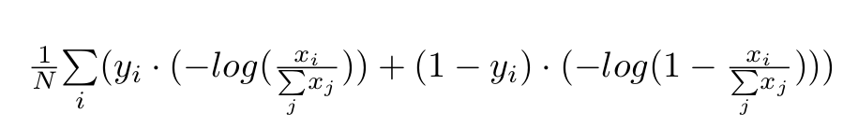
Sliding window + Revised O-NET for Fish Detection
Sliding Window: A fixed-size window scan the whole image, if there is fish, output [1, 0], otherwise [0, 1]
Minimize softmax cross entropy:

Slide 14
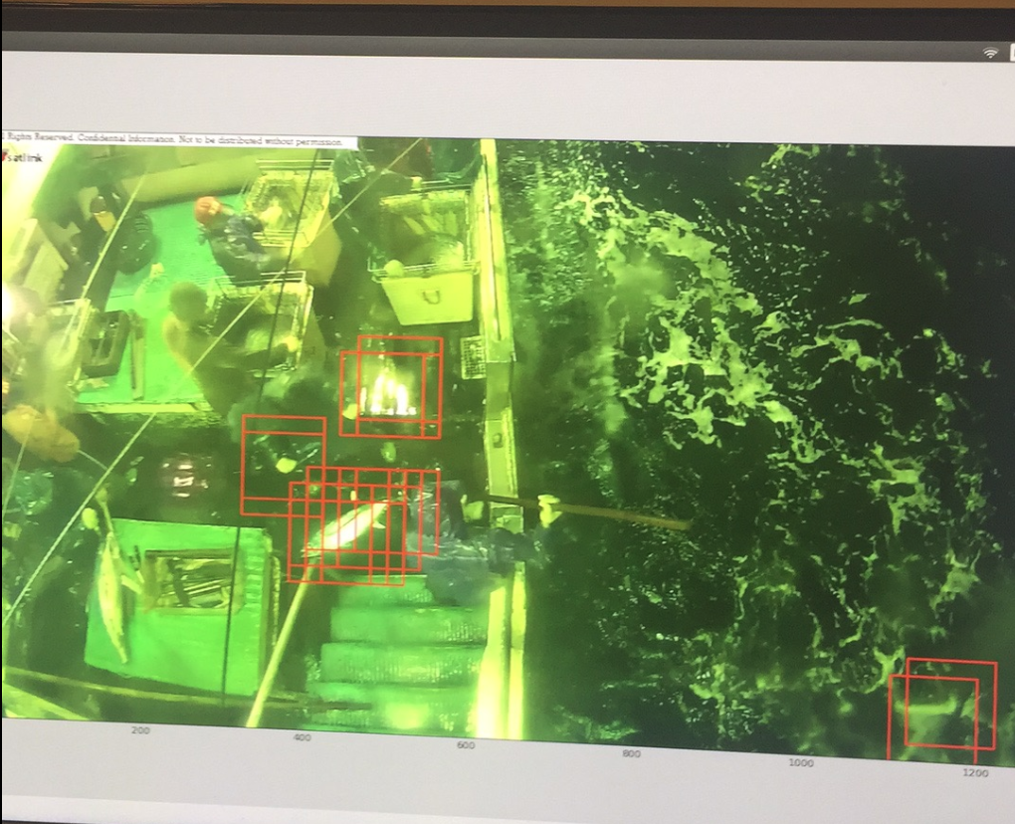

Slide 15
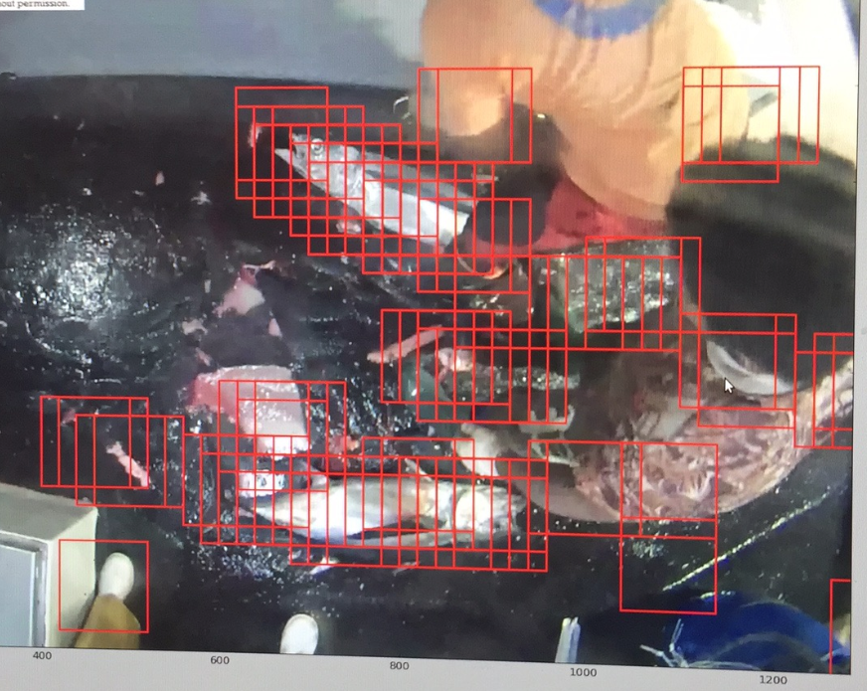

Slide 16
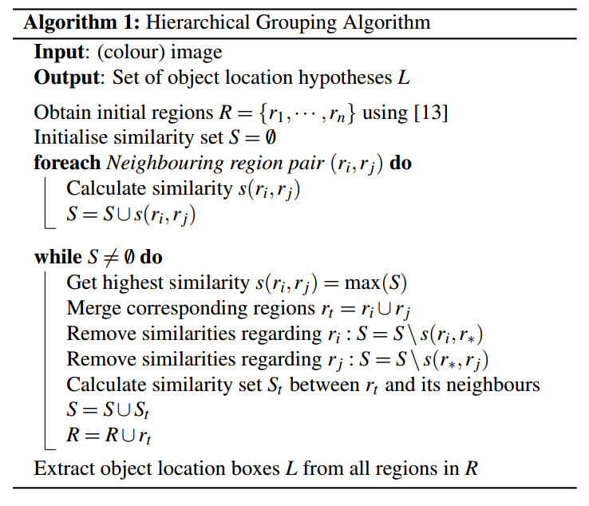
ROI(Selective search) + O-Net
Based on the paper IJCV13’ Selective Search for Object Recognition

Slide 17
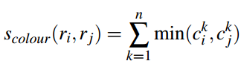
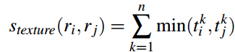
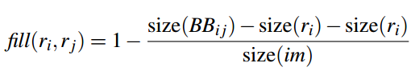
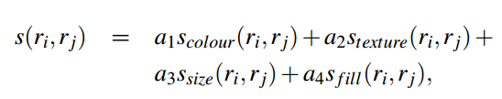
Similarity Measures
Color Measure:
Texture Measure:
Fill Measure:
Final Measure:

Slide 18
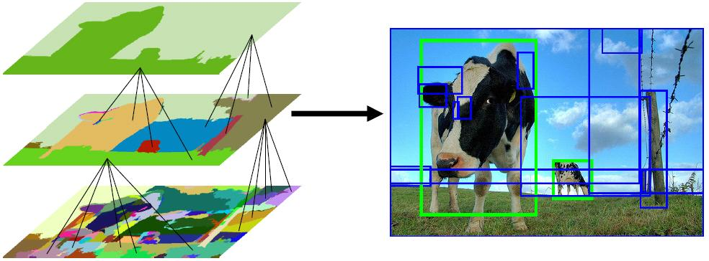

Slide 19
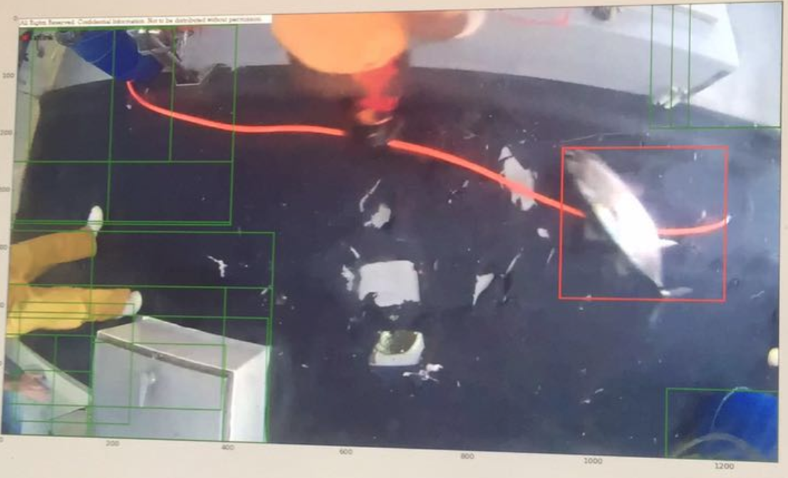

Slide 20
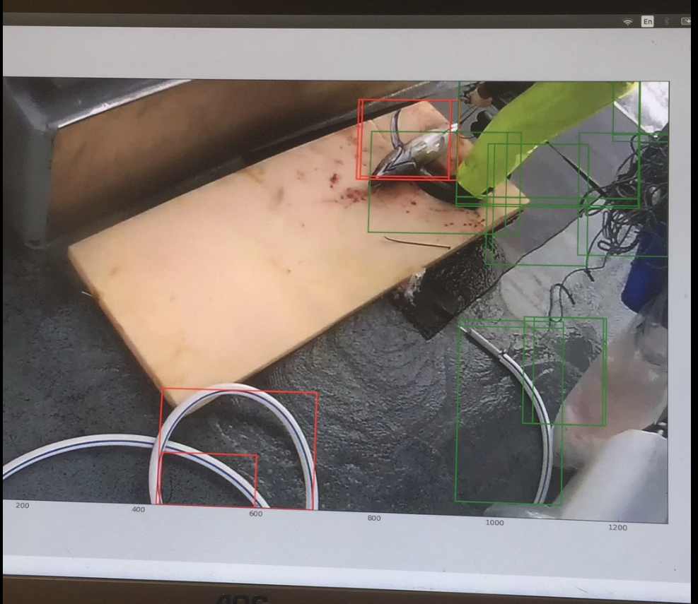

Slide 21
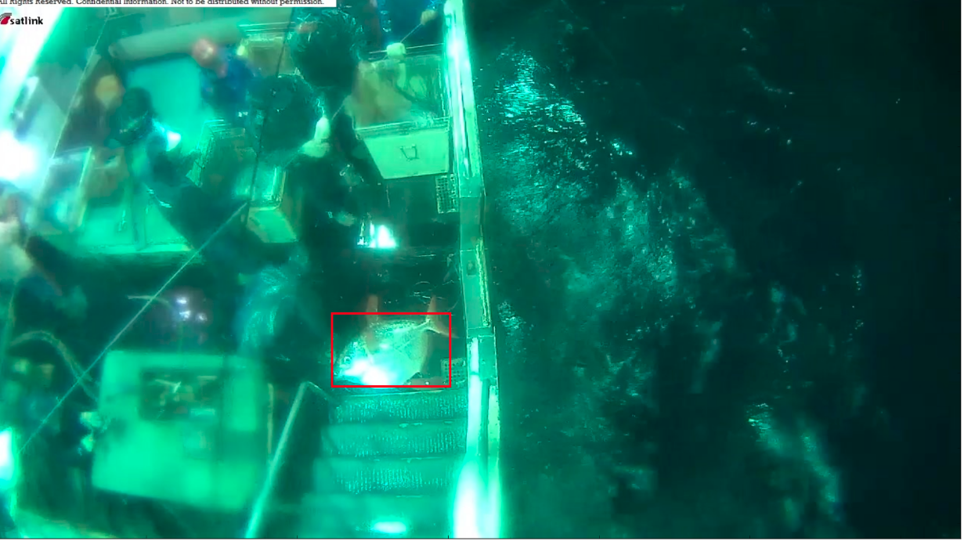

Slide 22
Pros and Cons of SS
Advantages:
more reasonable regions as compared with sliding window method
No non-maximal suppression(nms) needed
Disadvantages:
Computationally very expensive (at least O(n^3))
Sometimes the region proposal does not contain fish

Slide 23
Bounding box regression
Feed the whole image into a NN and outputs 4 values, top-x, top-y, width and height.
Out networks perform extremely bad

Slide 24
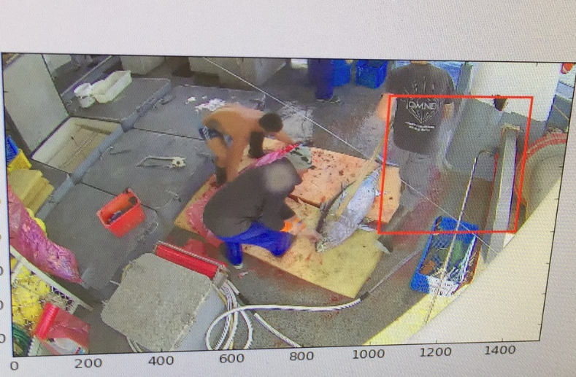

Slide 25
Whole image prediction
We have tried Zeiler&Fergus Net and VGG-16.
It turns out that whole image prediction with Zeiler&Fergus Net is the best out of all models.
The reasons that whole image prediction performs so good are:
Fish detection has many errors
There is correlation between the ship(boat) and the fish

Slide 26
Performances
First round prediction with 1000 test images: Rank 48 out of 2293 teams (top 2%)
Second round prediction with 12,000+ test images: Rank 224 out of 2293 teams (top 10%) due to the competition host change the boats as well as overfitting from first round
Finally won a bronze medal
https://www.kaggle.com/c/the-nature-conservancy-fisheries-monitoring/leaderboard

Slide 27
Codes and weights
https://github.com/yinhaoxiao/something2
The project is more than 500MB (not including images, more than 10GB including images) since the weights are very big. Feel free to download and run :)

Slide 28
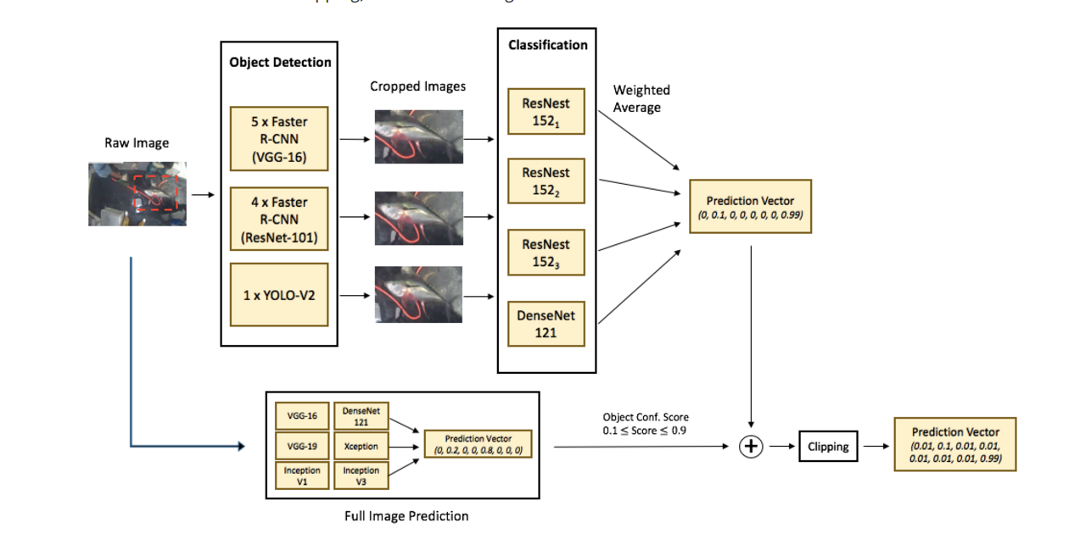
Solution shared by other contestant (8th in the competition)

